Slide 1
Eelo University Faculty of Computer sciences Microprocessor and Assembly Language

Slide 2

CHAPTER THREE
PENTIUM MICROPROCESSORS

Slide 3
Objectives
To describe the basic organization of the Pentium processor
To introduce the Pentium protected-mode memory architecture
To discuss the real-mode memory organization

Slide 4
The Pentium Processor
The name Pentium is originally derived from the Greek word pente (πέντε), meaning "five“ Pentium is a product used for a series of x86-compatible microprocessors produced by Intel since 1993.
In its current form, Pentium processors are considered entry-level products that Intel rates as "two stars", meaning that they are above the low-end Bit and Celeron series but below the faster Core i3, i5 and i7 lines as well as the high-end Xeon processors.

Slide 5
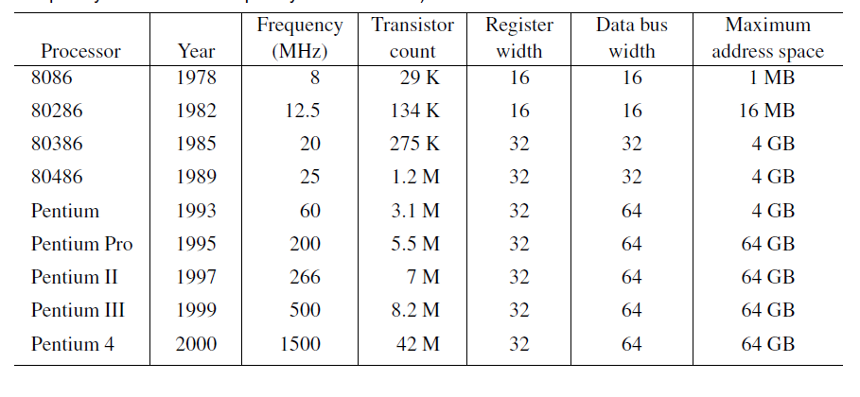
The Pentium Processor Family
Table 3.1 Key Characteristics of the IA Family of Processors (“Year” refers to the year of introduction; “Frequency” refers to the frequency at introduction)

Slide 6
The Pentium Processor Registers
Pentium has ten 32-bit registers and six 16-bit registers
Internal to the processor
Provide faster access
These registers are grouped into
General registers
Data registers
Pointer registers
Index registers
Control registers
Segment registers

Slide 7
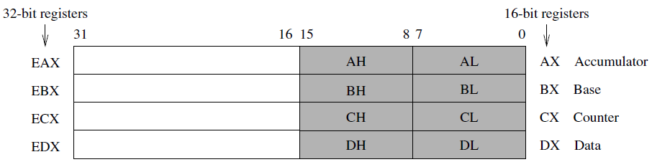
Data registers
There are four 32-bit data registers that can be used for arithmetic, logical, and other operations(see Figure).

Slide 8
Data Registers
These four registers are unique in that they can be used as follows:
Four 32-bit registers (EAX, EBX, ECX, EDX); or
Four 16-bit registers (AX, BX, CX, DX); or
Eight 8-bit registers (AH, AL, BH, BL, CH, CL, DH, DL).

Slide 9
Data registers
As shown in Figure, it is possible to use a 32-bit register and access its lower half of the data by the corresponding 16-bit register name. For example, the lower 16 bits of EAX can be accessed by using AX. Similarly, the lower two bytes can be individually accessed by using the 8-bit register names.

Slide 10
Data registers
For example, the lower byte of AX can be accessed as AL and the upper byte as AH.
The data registers can be used without constraint in most arithmetic and logical instructions.
However, some registers have special functions when executing specific instructions.
For example, when performing a multiplication operation, one of the two operands should be in the EAX, AX, or AL register depending on the operand size. Similarly, the ECX or CX register is assumed to contain the loop count value for iterative instructions.

Slide 11
Pointer and Index Registers
These registers can be used either as 16- or 32-bit registers.
The two index registers play a special role in string processing instructions (discussed in Chapter 10). In addition, they can be used as general-purpose data registers.
The pointer registers are mainly used to maintain the stack.
Even though they can be used as general-purpose data registers, they are almost exclusively used for maintaining the stack.

Slide 12
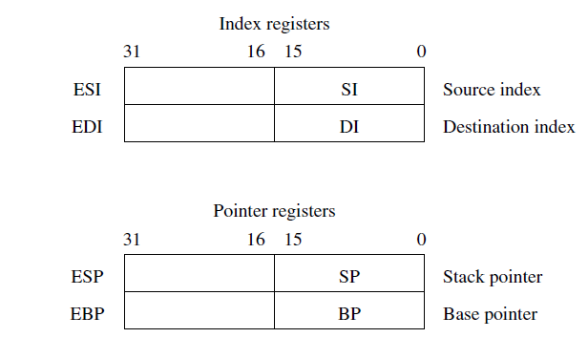

Slide 13
Control Registers
This group of registers consists of two 32-bit registers: the instruction pointer register and the flags register.
The processor uses the instruction pointer register to keep track of the location of the next instruction to be executed

Slide 14
The flags register can be considered as either a 16-bit FLAGS register or a 32-bit EFLAGS register.
The FLAGS register is useful in executing 8086 processor code. The EFLAGS register consists of 6 status flags, 1 control flag, and 10 system flags, as shown in Bits of this register can be set (1) or cleared (0).

Slide 15
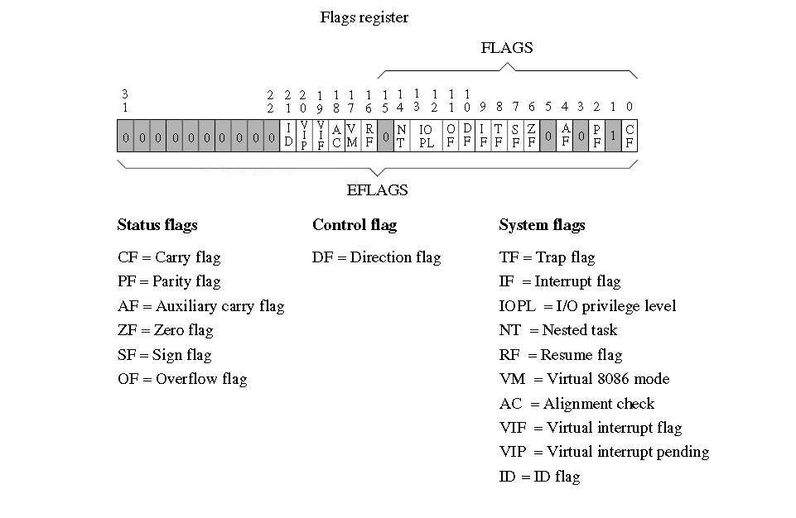
Flag Register

Slide 16
The six status flags record certain information about the most recent arithmetic or logical operation.
For example, if a subtract operation produces a zero result, the zero flag (ZF) would be set (i.e., ZF = 1).
The control flag is useful in string operations. This flag determines whether a string operation should scan the string in the forward or backward direction.

Slide 17
The 10 system flags control the operation of the processor.
The two interrupt enable flags—the trap enable flag (TF) and the interrupt enable flag (IF)—are useful in interrupt-related activities.
For example, setting the trap flag causes the processor to single-step through a program, which is useful in debugging programs.

Slide 18
Segment Registers
The six 16-bit segment registers of the Pentium are shown in.
These registers support the segmented memory organization of the Pentium.
In this organization, memory is partitioned into segments, where each segment is a small part of the memory.
The processor, at any point in time, can only access up to six segments of the main memory

Slide 19
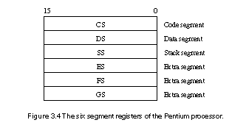

Slide 20
The six segment registers point to where these segments are located in the memory.
A program is logically divided into two parts: a code part that contains only the instructions, and a data part that keeps only the data.
The code segment (CS) register points to where the program’s instructions are stored in the main memory, and the data segment (DS) register points to the data part of the program.

Slide 21
The stack segment (SS) register points to the program’s stack segment
The last three segment registers—ES, FS, and GS—are additional segment registers that can be used in a similar way as the other segment registers.
For example, if a program’s data could not fit into a single data segment, we could use two segment registers to point to the two data segments.

Slide 22
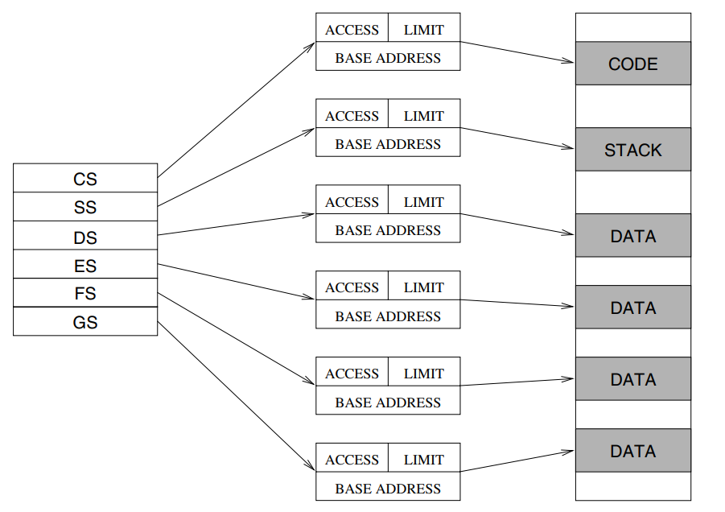
Segments in a multi segment model.

Slide 23
The Pentium protected-mode memory architecture
Protected mode is a mode of program operation in a computer with an Intel-based microprocessor in which the program is restricted to addressing a specific contiguous area of 640 kilobytes.
Intel's original PC microprocessor, the 8088, provided a one megabyte (1 Mbyte) random access memory (RAM).
The memory was divided into several areas for basic input/output system data, signals from your display, and other system information.

Slide 24
Cont….
The remainder or 640 kilobytes of contiguous space was left for the operating system and application programs.
The 8088 ensured that any instruction issued by a program running in protected mode would not be able to address space outside of this contiguous 640 kilobytes.
Typically, much operating system code and almost all application programs run in protected mode to ensure that essential data is not unintentionally overwritten.

Slide 25
Cont. …
Real mode is program operation in which an instruction can address any space within the 1 megabyte of RAM. Typically, a program running in real mode is one that needs to get to and use or update system data and can be trusted to know how to do this. Such a program is usually part of the operating system or a special application subsystem.

Slide 26
The 8086 Microprocessor- Internal Architecture
The Intel 8086 is a 16-bit microprocessor intended to be used as the CPU in a microcomputer. The term “16-bit” means that its arithmetic logic unit, internal registers, and most of its instructions are designed to work 16-bit binary words. It has 16-bit data bus and 20-bit address bus.
Words will be stored in two consecutive memory locations. If the first byte of a word is at an even address, the 8086 can read the entire word in one operation. If the first byte of the word is at an odd address, the 8086 will read the first byte in one operation, and the second byte in another operation.
Following figure shows the internal block diagram of 8086 microprocessor.

Slide 27
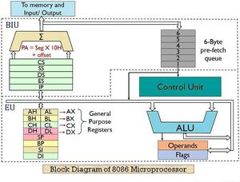
The 8086 CPU is divided into two independent functional parts, the bus interface unit or BIU, and the execution unit .

Slide 28
Memory segmentation:
In order to increase execution speed and fetching speed, 8086 segments the memory.
Its 20-bit address bus can address 1MB of memory, it segments it into 16 64kB segments.
8086 works only with four 64KB segments within the whole 1MB memory.
The internal architecture of Intel 8086 is divided into 2 units: The Bus Interface Unit (BIU), and The Execution Unit (EU).

Slide 29
Real-mode memory organization
Real mode, also called real address mode, is an operating mode of all x86-compatible CPUs.
The mode gets its name from the fact that addresses in real mode always correspond to real locations in memory.
Real mode is characterized by a 20-bit segmented memory address space (giving 1 MB of addressable memory) and unlimited direct software access to all addressable memory, I/O addresses and peripheral hardware.
Real mode provides no support for memory protection, multitasking, or code privilege levels.

Slide 30
The end

